Slide 1
CAMEO Names
JRC-NAMES: A Freely Available, Highly Multilingual
Named Entity Resource

Slide 2
CAMEO Data Set
Phoenix.agents.txt
Lines Processed for Cameo.Phoenix.agents is : 2292
Records created for Cameo.Phoenix.agents is : 1972
Phoenix.Countries.actors.txt
Lines Processed for Cameo.Phoenix.Countries.actors is : 54410
Records created for Cameo.Phoenix.Countries.actors is : 286
Phoenix.International.actors.txt
Lines Processed for Cameo.Phoenix.International.actors is : 7976
Records created for Cameo.Phoenix.International.actors is : 7526
Phoenix.MilNonState.actors.txt
Lines Processed for Cameo.Phoenix.MilNonState.actors is : 2680
Records created for Cameo.Phoenix.MilNonState.actors is : 959

Slide 3

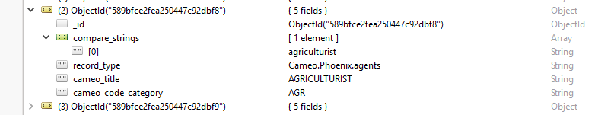
Phoenix.agents

Slide 4
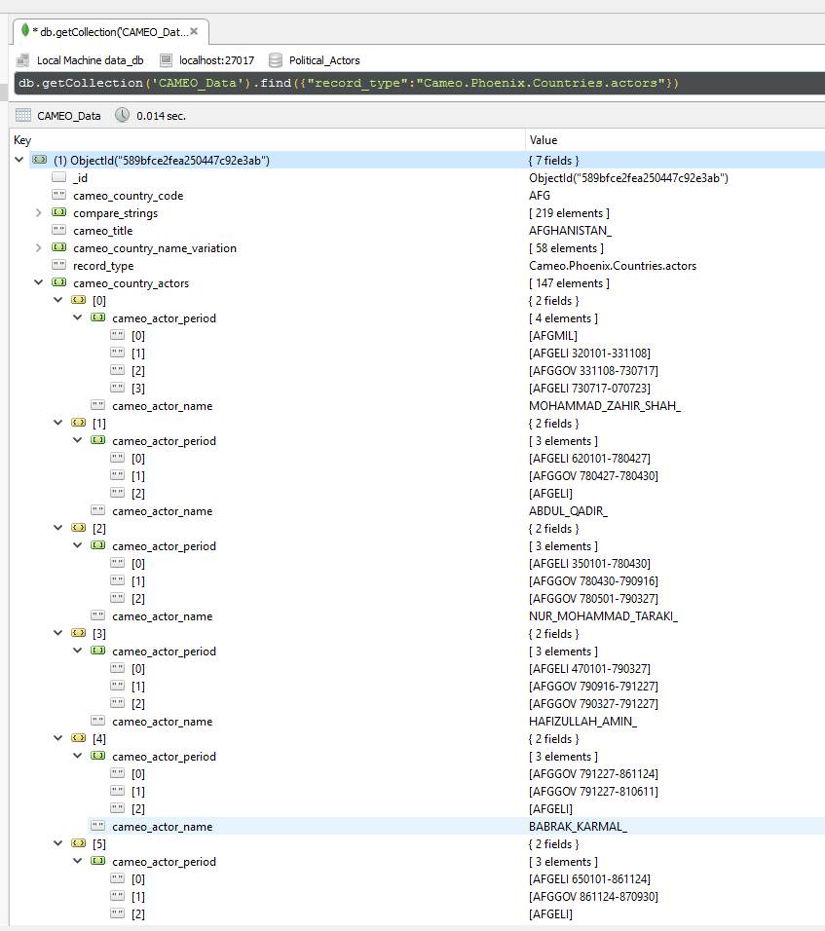
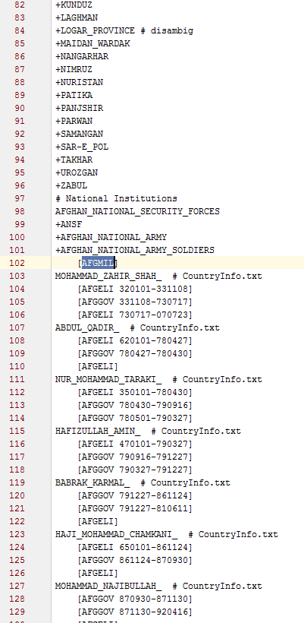
Phoenix.Countries.actors

Slide 5
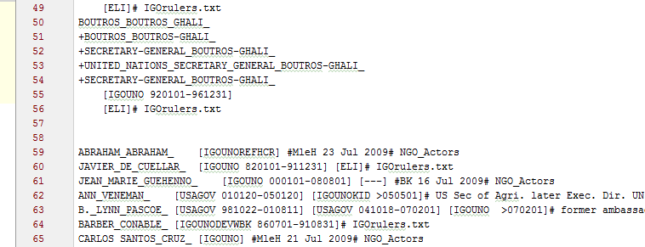
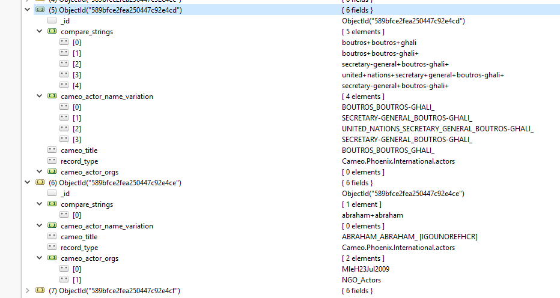
Phoenix.International.actors & Phoenix.MilNonState.actors

Slide 6
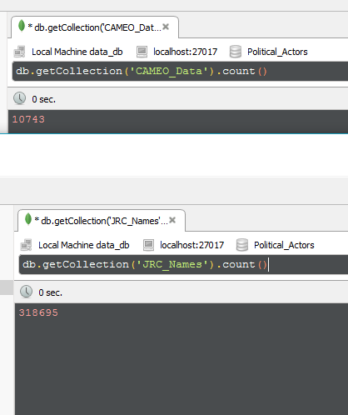
3,423,740,385,000 approx.. String comparisons needed for finding relation

Slide 7
CAMEO_JRC_Relation
{
"_id" : <Record ID>
"jrc_id" : <Record ID in JRC_Names table>
"jrc_code" : <JRC ID for the entity>,
"cameo_title" : “<CAMEO Title / country name for connected record>",
"cameo_id" : <Record ID in CAMEO_Data table>
"compare_string" : <String compared that can be hashed or indexed for serch> Eg: "chamber+of+commerce"
}

Slide 8
Stats
Total Records found by many-to-many string comparison : 7427
Approx. ~7000 unique entities (Person/Organisation)
Most relation found in Phoenix.Countries.actors – 6423 connections
Time to generate the data after running 4 instances targeting 4 different CAMEO files separately all running in parallel: 11 hours
Time to generate data only from Phoenix.Countries.actors : 55 minutes
Better Improvement possible with Apache Spark.
Data: https://github.com/SubhasisDutta/CAMEO-JRC-Database/blob/master/data/cameo_jrc/cameo_CountryActors_with_jrc.txt

Slide 9
Implementation using Edit Distance
Done using Edit Distance
Insertion or Deletion : 1
Substitution : 1
Cameo-JRC join script on a small data set of 219 entities
out of which 147 are person names which have a chance of being in JRC
# of Cameo Entity Matched | 0 Edit Distance(Exact Match) | 1 Edit Distance | 2 Edit Distance | 3 Edit Distance | 4 Edit Distance
219 (# of persons 147) | 54 | 199 (145) | 429 (230) | 1115 | 8163
False Positive (connection not detected found by manual lookup) | >50 | ~14
False Negative | 0 | 21 | > 100 | > 60 %

Slide 10
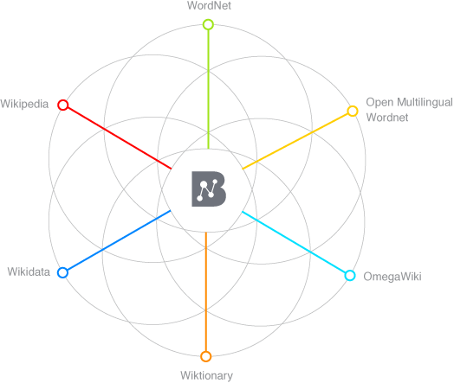
BableNet

Slide 11
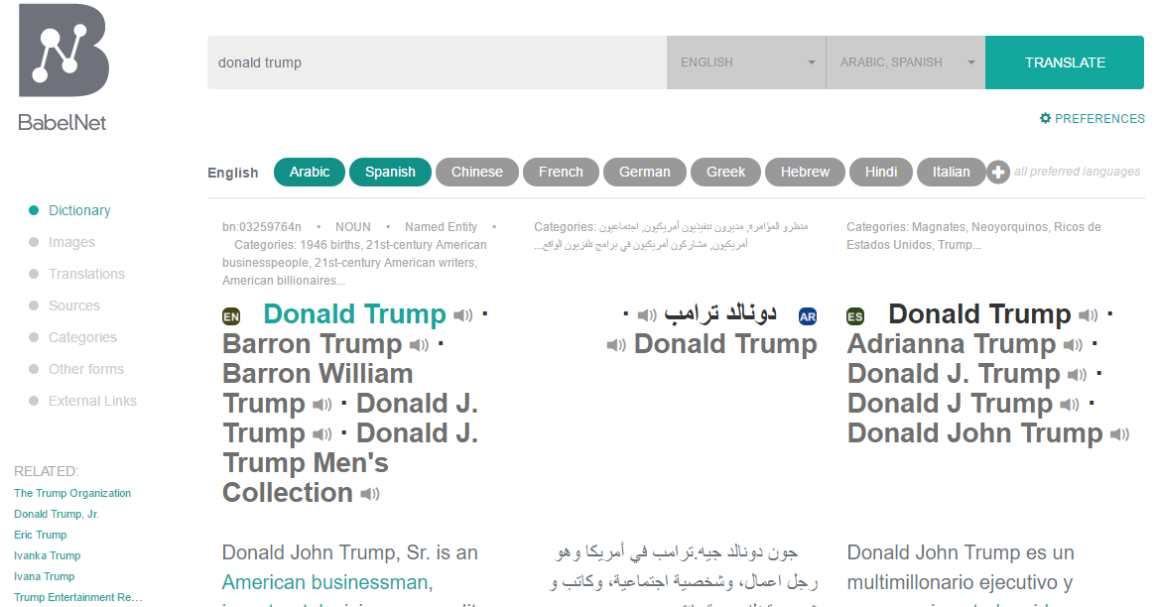
Search for Donald Trump for Lang (AR and ES) http://babelnet.org/synset?word=bn:03259764n&details=1&lang=EN&langTrans=AR&langTrans=ES&orig=donald%20trump

Slide 12
BableNet API https://babelnet.io/v4/getSenses?word=donald_trump&lang=EN&pos=NOUN&filterLangs=AR&filterLangs=ES&key=284fd255-4315-4e6e-b6c9-f7a6409bc815
Given Name , Language of the name and Languages in which the conversion is required .
[ { "lemma":"دونالد_ترامب",
"simpleLemma":"دونالد_ترامب",
"source":"WIKIDATA",
"sensekey":"Q22686#1",
"language":"AR",
"pos":"NOUN",
"synsetID":{
"id":"bn:03259764n", "pos":"NOUN",
"source":"BABELNET" },
"translationInfo":"",
]
{
"lemma":"Donald_Trump", "simpleLemma":"Donald_Trump", "source":"WIKI",
"sensekey":"", "sensenumber":0, "frequency":417, "position":1,
"language":"ES", "pos":"NOUN", "synsetID": {
"id":"bn:03259764n", "pos":"NOUN",
"source":"BABELNET"
},
},

Slide 13

Integrate BableNet with our database on demand
Interface
UTD Language Databse

Slide 14
Reference
CAMEO Data: https://github.com/openeventdata/UniversalPetrarch/tree/master/UniversalPetrarch/data/dictionaries
Code Repo : https://github.com/SubhasisDutta/JRC-Name-Parser

